Slide 1
Inatel Developer Program
IDP Labs
GIT
Criado por:
Vitor Figueiredo
Atualizado em
10 out 2022
Versão:
1

Slide 2

Agenda
Instalação
GIT Básico
GIT Branch Model

Slide 3
Instalação

Slide 4
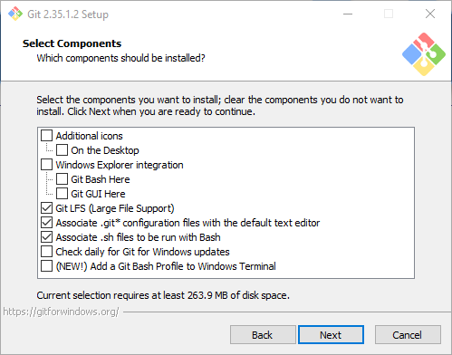
Instalação
Passo 1 de 17

Slide 5
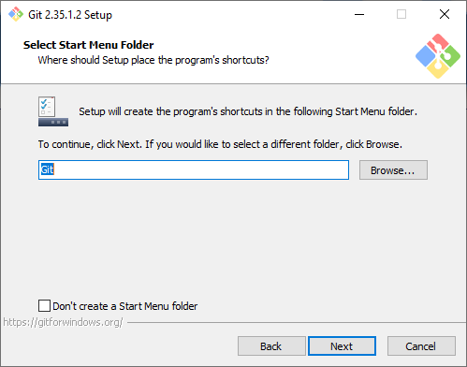
Instalação
Passo 2 de 17

Slide 6
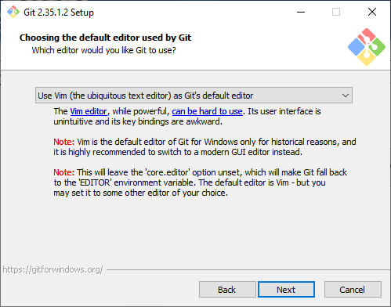
Instalação
Passo 3 de 17

Slide 7
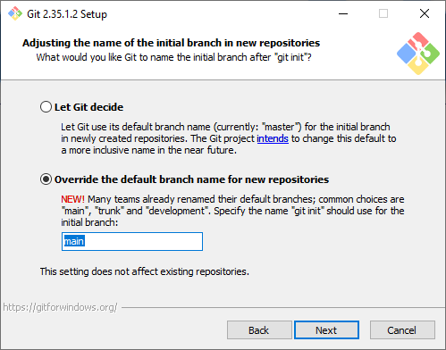
Instalação
Passo 4 de 17

Slide 8
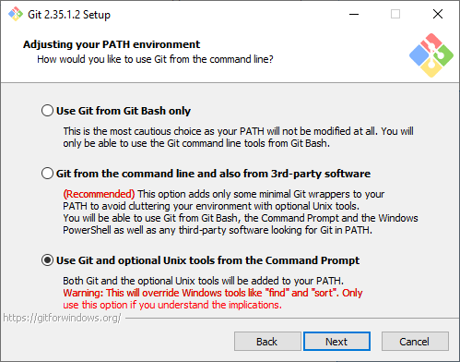
Instalação
Passo 5 de 17

Slide 9
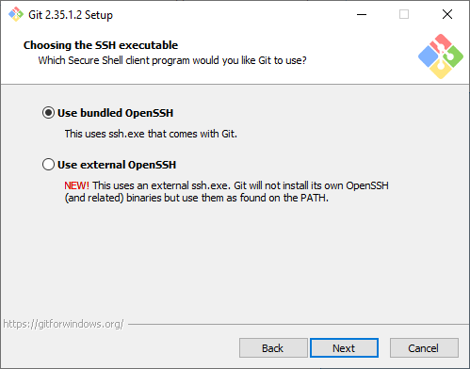
Instalação
Passo 6 de 17

Slide 10
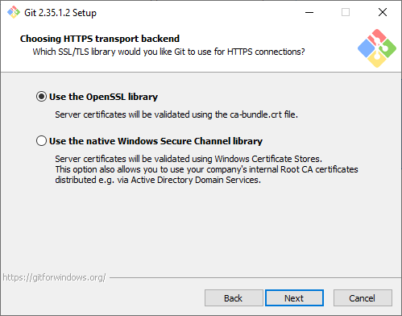
Instalação
Passo 7 de 17

Slide 11
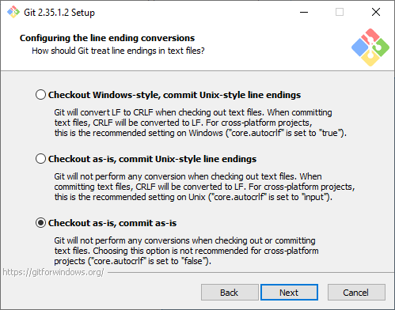
Instalação
Passo 8 de 17

Slide 12
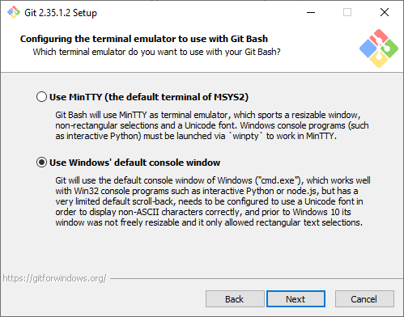
Instalação
Passo 9 de 17

Slide 13
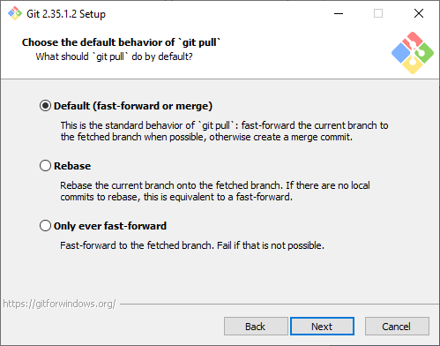
Instalação
Passo 10 de 17

Slide 14
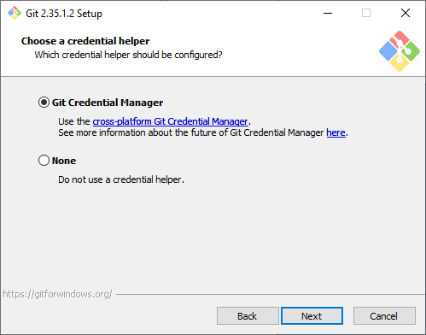
Instalação
Passo 11 de 17

Slide 15
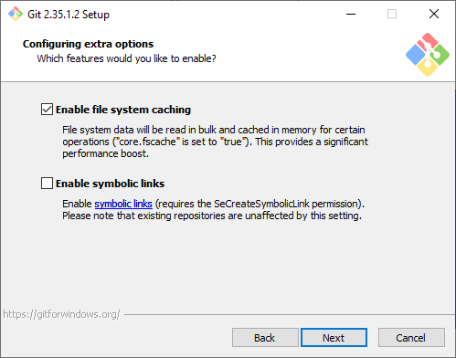
Instalação
Passo 12 de 17

Slide 16
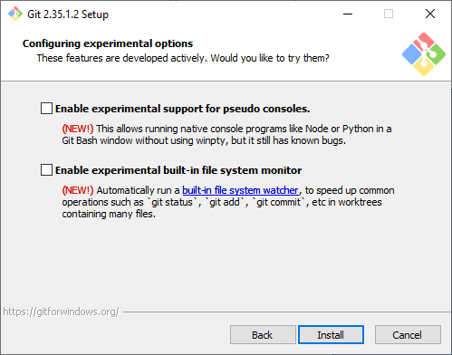
Instalação
Passo 13 de 17

Slide 17
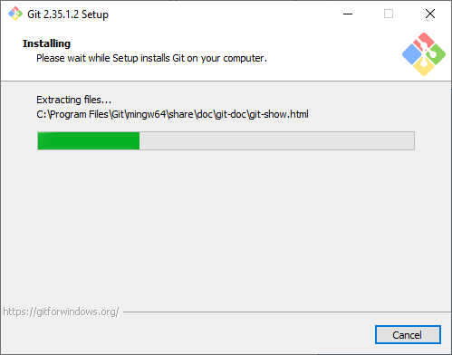
Instalação
Passo 14 de 17

Slide 18
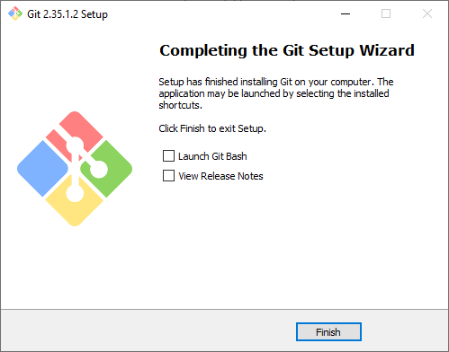
Instalação
Passo 15 de 17

Slide 19
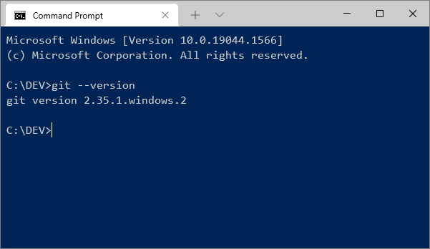
Instalação
Para testar a instalação, abrir o terminal de comando e digitar:
git --version

Slide 20
GIT Básico
concepts, commands...

Slide 21
About GIT
Modern Source Code Managment (SCM)
Distributed Version Control System (DVCS)
Ultra fast
Based on Branch Model
Created by Linus Torvalds for Linux Kernel

Slide 22
CVS x GIT
CVS
GIT
1990
File versioning
Centralized (Server/Client)
Weak Branch Model
2005
Repository versioning
Distribuited (Remote/Local)
Strong Branch Model

Slide 23
GIT :: Repositories
git clone
Local Repository
git pull
Remote Repository
(origin)
git push

Slide 24
GIT :: Internal Local Repository
Local Repository
Any modification
HEAD
Staging Area
Working Tree
git add
git commit

Slide 25
GIT :: Repositories
Local Repository
Remote Repository
(origin)
git pull
H
SA
WT
git push
Sempre execute git pull antes de git push

Slide 26
GIT :: Open Services
https://bitbucket.org/
https://github.com
Free private repositories
Private repositories are paid

Slide 27
Let´s setup GIT:
Desktop Setup
BitBucket Setup
Clone the Project
Commit the changes

Slide 28
1) Desktop Setup
Download from:
https://git-scm.com/download/win
Install GIT client
Config GIT
git config --global user.name “vitor.ac.figueiredo”
git config --global user.email “vitor.ac.figueiredo@gmail.com”

Slide 29
2) Bitbucket Setup
Create a account (using Google Account)
Create the repository “Hello GIT”
Edit the README
Copy the HTTPS URL

Slide 30
3) Clone the project
Open a prompt window
mkdir c:\DEV
cd c:\DEV
git clone https://...

Slide 31
4) Commit the changes
Make some changes in README file
Commit the changes
git add .
git commit –m “a message about the changes made”
git push

Slide 32
GIT Basic Operations

Slide 33
Showing status
git status

Slide 34
Showing commits
git log
git log –decorate --oneline

Slide 35
Reverting changes (in HEAD)
git checkout -- filename.txt

Slide 36
GIT Avançado
branch model...

Slide 37
master
commit
commit
commit
commit
commit

Slide 38
Bug#1_QueryTimeout
master
RefactoringDateUtil

Slide 39
Creating and changing to a new Branch
$ git checkout -b Bug#1_QueryTimeout
Bug#1_QueryTimeout
Master

Slide 40
Listing the branchs
$ git branch
* Bug#1_QueryTimeout
master
Bug#1_QueryTimeout
Master

Slide 41
Changing the branch
$ git checkout master
Bug#1_QueryTimeout
Master

Slide 42
Deleting a branch
$ git branch -d Bug#1_QueryTimeout
Deleted branch Bug#1_QueryTimeout (was 2f3f40c).
Bug#1_QueryTimeout
Master

Slide 43
Merging branches (to master)
$ git checkout master
$ git merge Bug#1_QueryTimeout
Bug#1_QueryTimeout
2
master
1

Slide 44
Merging branches (from master)
$ git checkout Bug#1_QueryTimeout
$ git merge master
Bug#1_QueryTimeout
1
2
master

Slide 45


Slide 46
Obrigado

